Slide 1
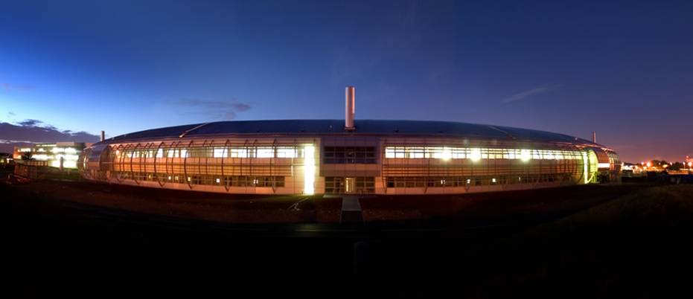
Diamond Light Source
Mark Heron
Head of Controls Group
A Decade of EPICS on Diamond

Slide 2
Content
Introduce Diamond
Key Diamond events over past decade
Significant developments in EPICS over the past decade
Technologies for today
Consider future
A Decade of EPICS on Diamond
EPICS Collaboration Meeting 1st – 3rd May 2013

Slide 3
Diamond Light Source Ltd
Diamond Light Source Ltd. is a Joint Venture Company.
Its shareholders are:
86 %
The Science and Technology Facilities Council is an independent, non-departmental public body.
14 %
The Wellcome Trust is an independent charity funding research to improve human and animal health. It is the UK's largest non-governmental source of funds for biomedical research.

Slide 4
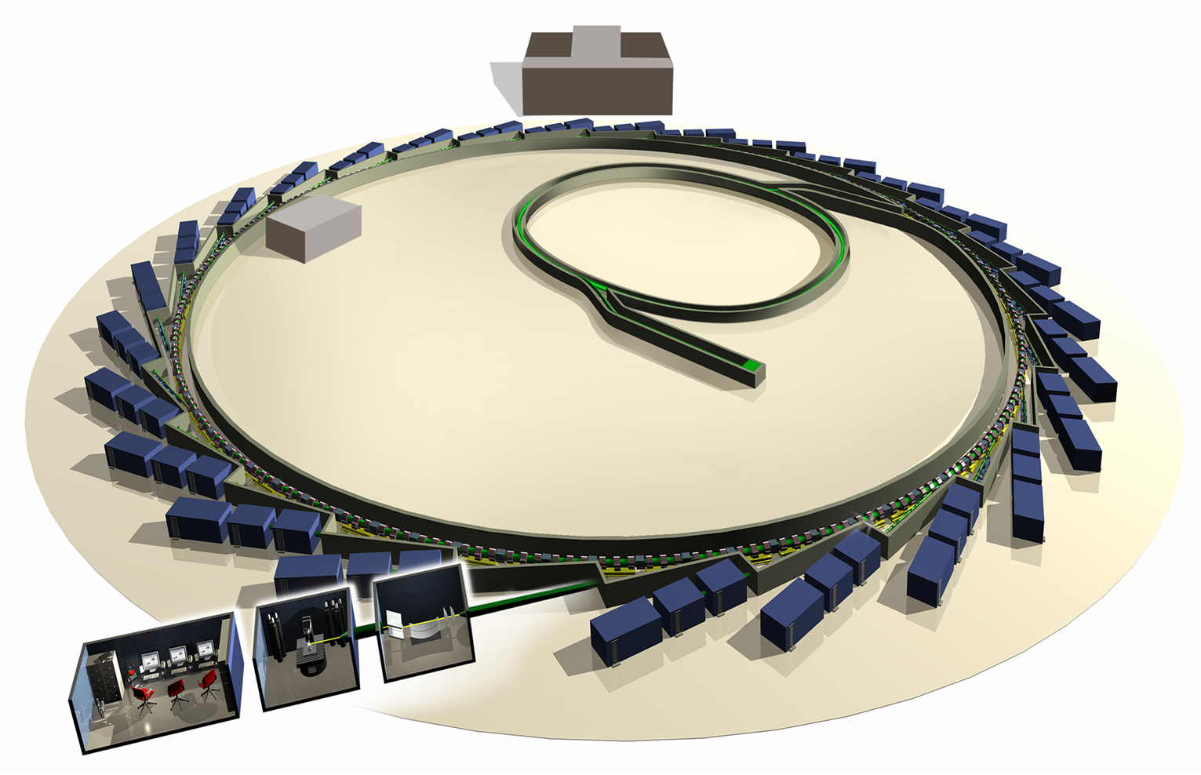
Diamond Accelerators
Storage Ring Continuous 3 GeV 1.5 nC to 0.5 µC 0.8 mA to 300 mA
Booster Pulsed 5 Hz 100 MeV to 3 GeV 1.5 nC 3 mA
Linac Pulsed, 5Hz
0 MeV to 100 MeV 3 nC 15 nA
Diamond Control System Installation and Commissioning and Management

Slide 5
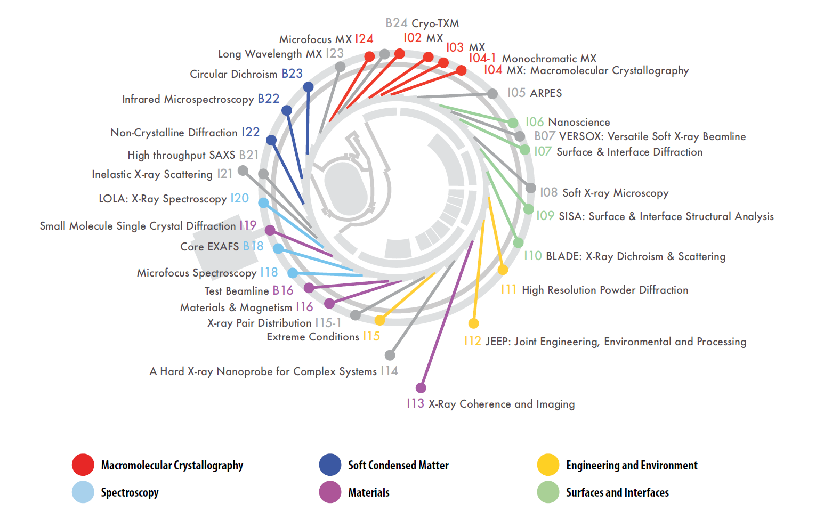
Beamline Science Villages

Slide 6
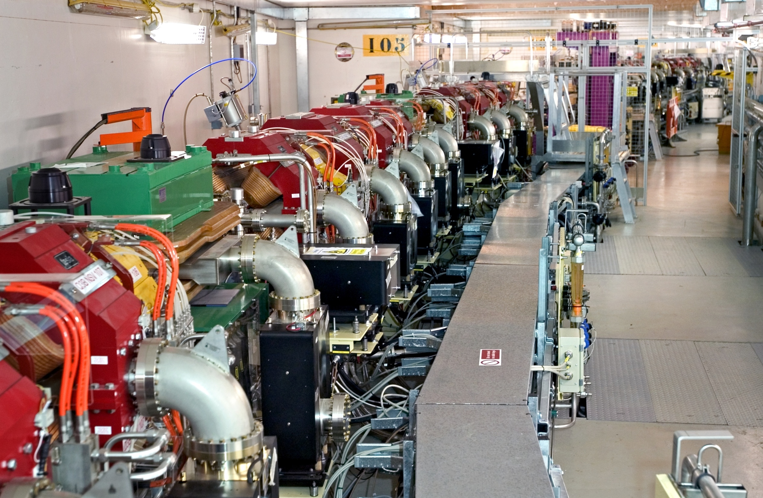

Slide 7
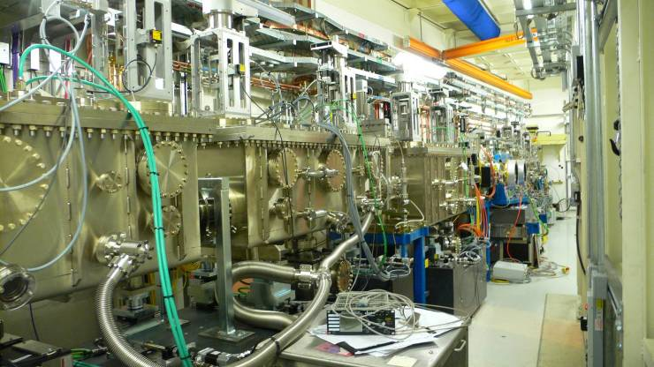

Slide 8
Key Diamond Events Over Past Decade
EPICS Meeting @ Diamond
EPICS Meeting @ Diamond & ISIS
FOFB Oper.
Ph 2, 15 BLs
funded
First Controls Staff on Site
Linac Comm
Central Computing
Beam Booster
Top Up
Oper
Beam SR
Foundations complete
1st Users
7 BL’s
Ph 3, 10 BLs Funded
Ph 2 BLs Complete
2003
2004
2005
2006
2007
2008
2009
2010
2011
2012
2013

Slide 9
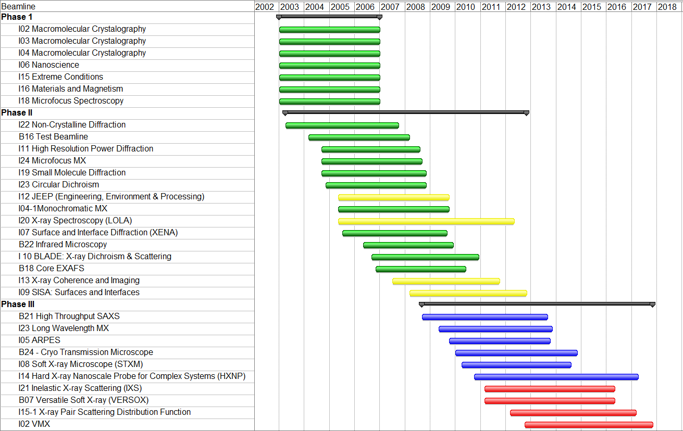
Beamline Schedule
Operational (
Optimisation
Construction
Design

Slide 10
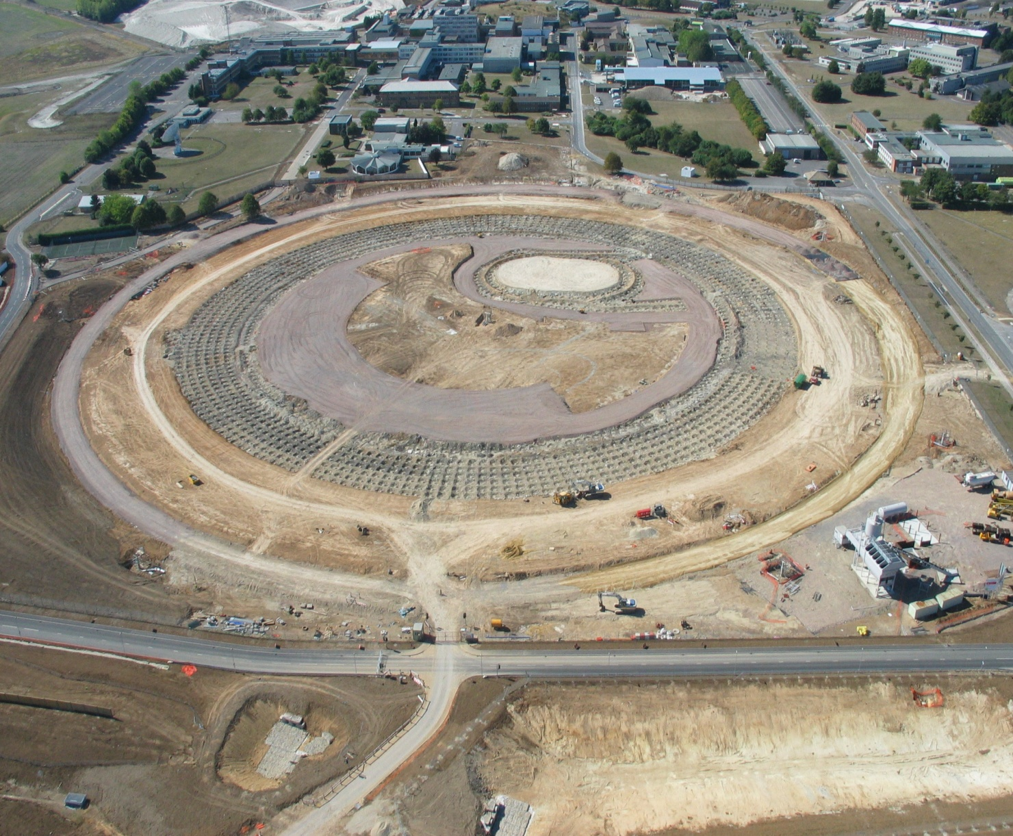
Diamond 2003

Slide 11
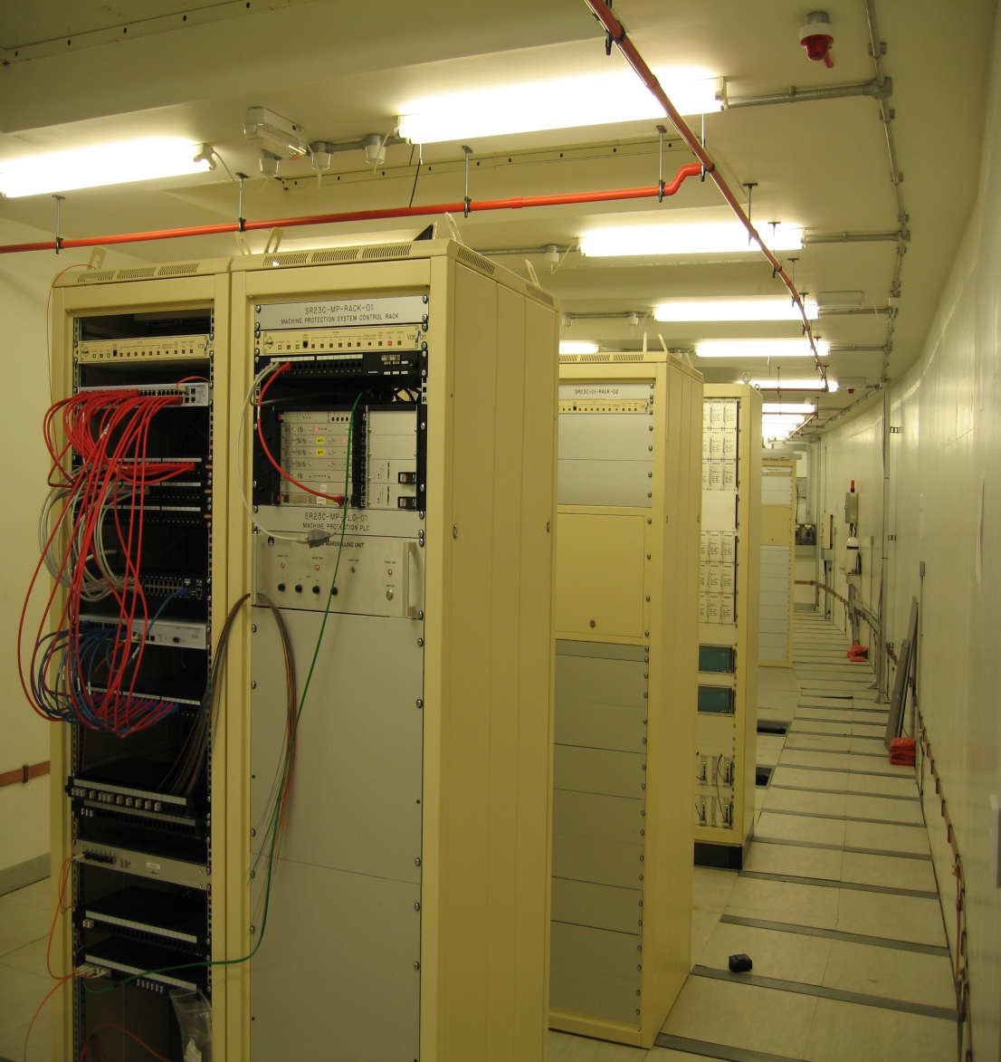
Original Control System Architecture
Linux RH 9.0/EL3
EPICS 3.13.9
VME and MVME5500
IP modules for most IO
Very conservative
Reused proven solutions
Developed and deployed 260 IOCs and ~300k PVs in 3 years
It just worked !!

Slide 12
Support From Industry
Key to managing peak workload
Turnkey systems with EPICS
Linac, RF Amplifiers, RF cavities, Girder alignment, Monochromators, Beamline optics
Today you can buy black boxes with EPICS
Libera BPM, Motor controllers, Cryocoolers ......
Technical support available commercially
Commissioning and development effort
EPICS consultants
Examples include Hytec Electronics, Observatory Science, CosyLab, Tessella, Dsoft,
Measure of maturity of EPICS

Slide 13
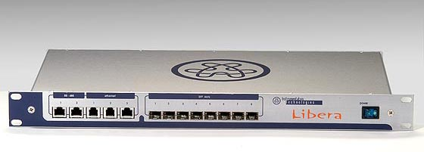
3.14
Gave VxWork independence
Removed the $10k entry barrier
Opened up EPICS to smaller projects
Marty tried to convince me to take 3.14.1 for the Diamond machine
I felt there wasn't time.
Michael Abbott used 3.14.6 for Libera BPMs
Nick Rees used 3.14.7 for Diamond beamlines
Migrated all controls to 3.14.8.2 from 2009 and then to 3.14.11

Slide 14
Serial Device/Protocol Support
In 2001
“Diamond Control Systems needed to support 2116 serial devices”
Sharp intake of breath
Made we us think about this evaluate options
Selected Streamdevice
Removed need for hard coding protocols
Separation of the definition of protocol from EPICS record
Worked very well
# Frequency is a float
# use ai and ao records
getFrequency {
out "FREQ?"; in "%f";
}
setFrequency {
out "FREQ %f";
@init { getFrequency; }
}
A Decade of EPICS on Diamond
EPICS Collaboration Meeting 1st – 3rd May 2013

Slide 15
Asyn
2003 Spring EPICS meeting Marty was soliciting interest in an asynchronous IO subsystem for IOCs
Asyn R1-0alpha2 released 2004
Enabled the move away from bus based IO
Abstraction of the hardware interface
Simplified Device development
Motor Record 1
AI
devMotorAsyn
devAsynFloat64
Asyn Port
drvMotorAsyn
pmacAsynMotor
Asyn Octet
pmacAsynIPPort (interpose - optional)
VME or Socket or Serial Port interface
PMAC Motor Controller

Slide 16
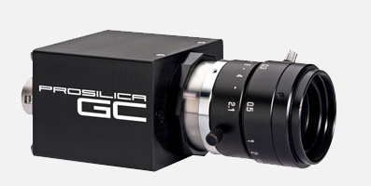
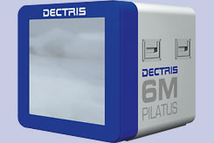
Area Detector
Moved EPICS into data acquisition
2D detectors, CCDs, pixel array detectors
Image processing structure
Server side
Plugin based
Gives performance
Configurable on the fly
Controlled through EPICS
Range Detectors/Cameras support
Data Streams other than CA
Fast file systems
Lustre and GPFS 900 MB/sec
ffmpegServer

Slide 17
Photon Beam Control and Data Acquisition
EPICS Apps EDM/Alarm/Arch
GDA Scripting
GDA
Applications
GDA Client
High Performance
File System
GDA Server
CA Client
Acc
CA
server
BL Vac
CA Server
BL PSS
CA Server
BL Motor
Drives CA
Server
Detector
CA
Server
Detector IF or Area Detector
Storage Ring,
IDs, FEs
Photon Beamline
Experiment/Detector

Slide 18
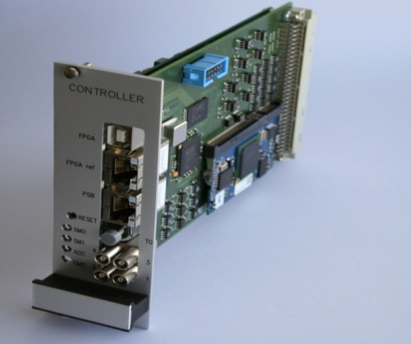
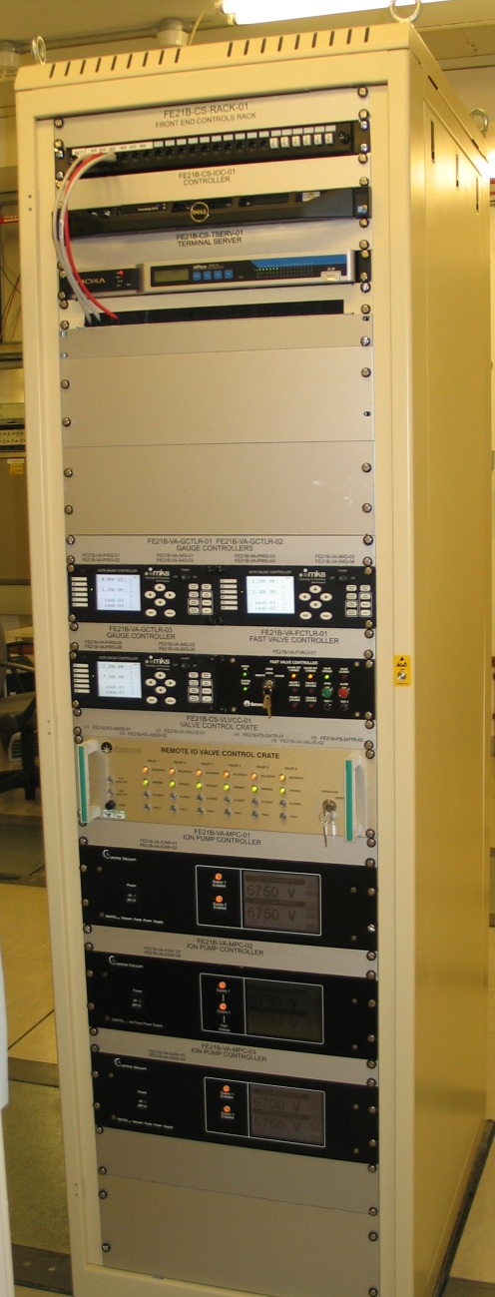
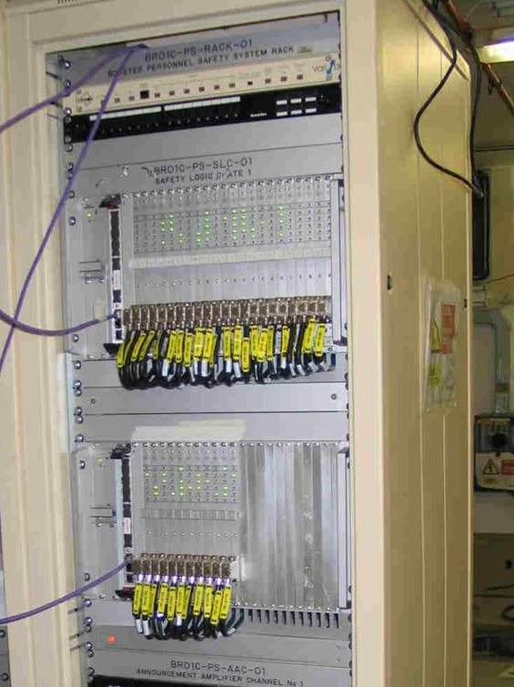
Linux
Linux
Commercial from Red Hat
Include RT extensions
In-house built
X86 PCs
Development
Operations
Compute Clusters
1U PCs for IOCs
RT extensions
VME PPC
Replacing VxWorks
ARMs processors
Libera BPMs
PSU controllers
Windows IOCs (~20)
Mostly associated with detectors

Slide 19
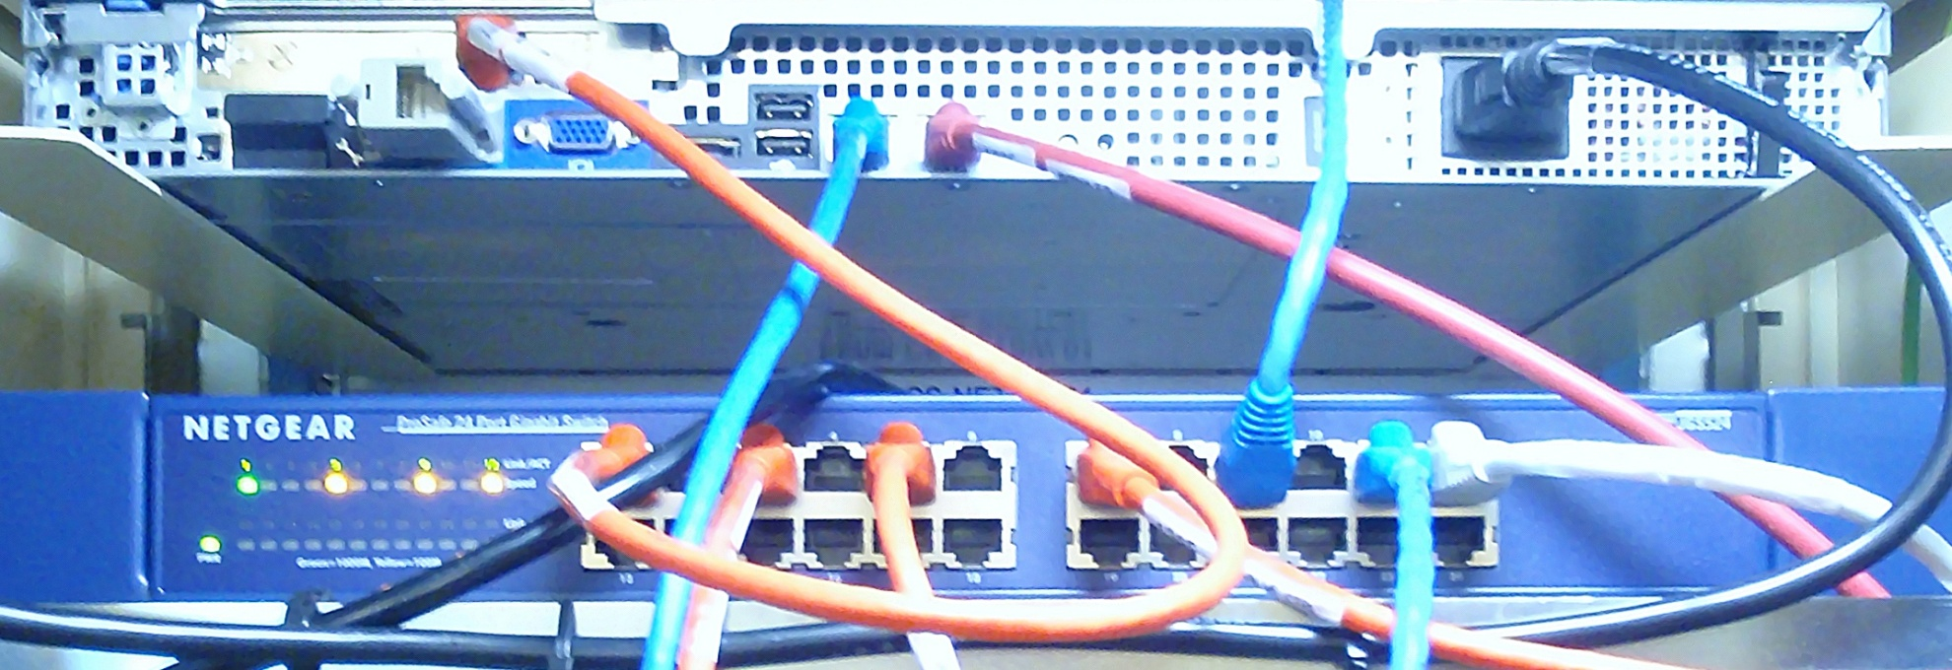
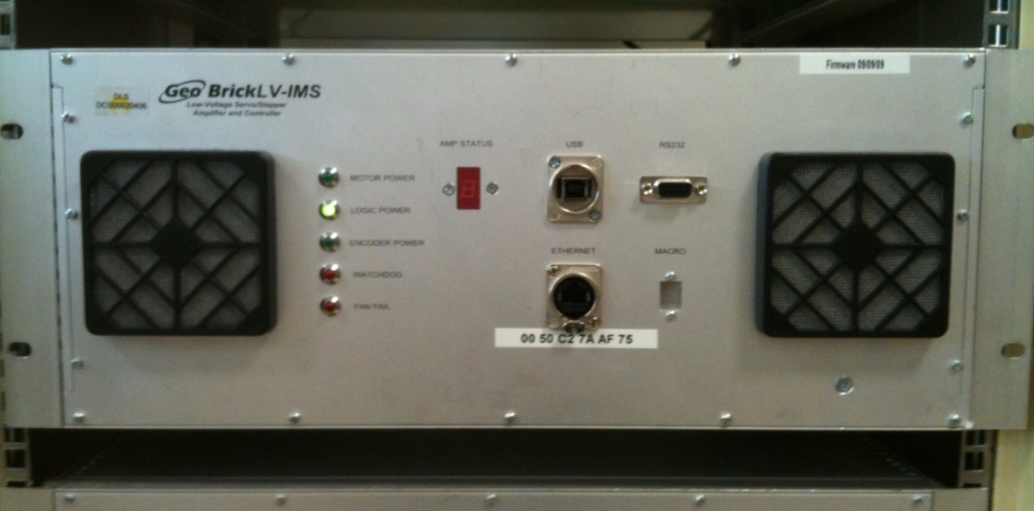
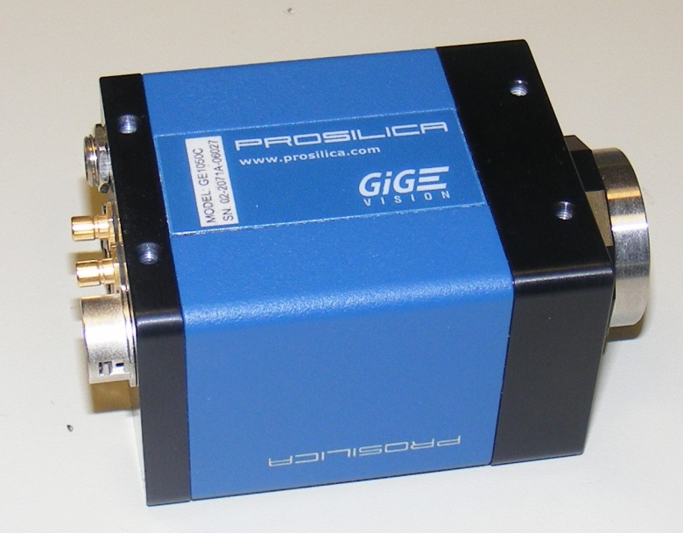
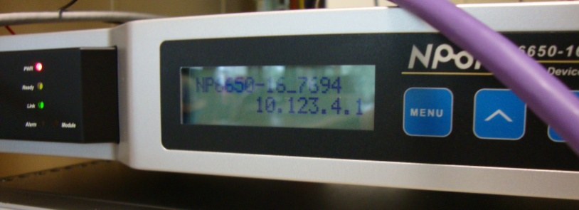
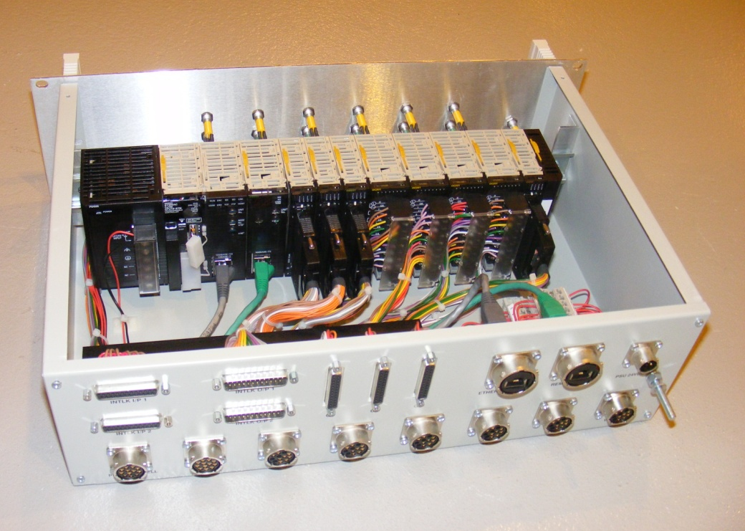
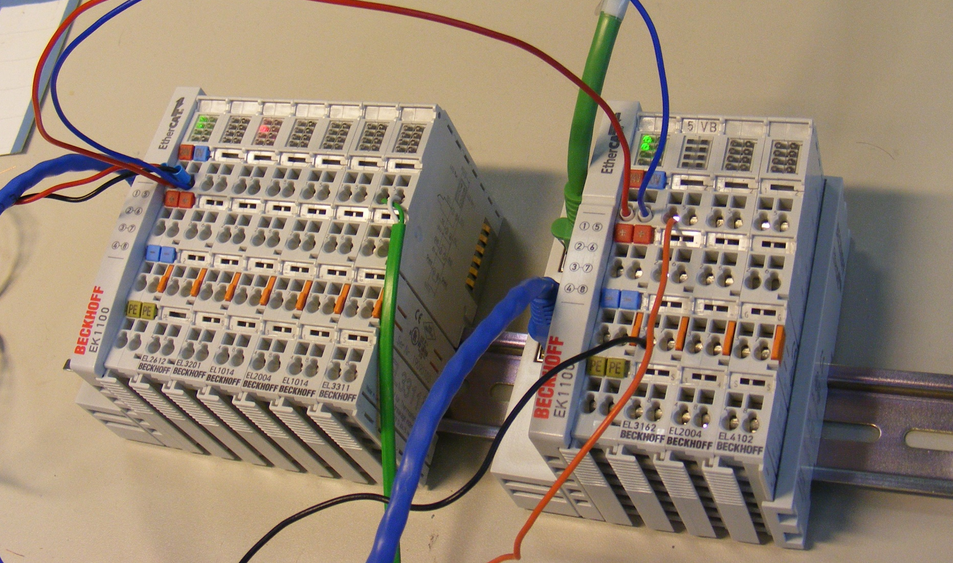
Ethernet
Extended beyond traditional client server to become the IO bus
Replacing VME/cPCI
Ethernet attached IO
ADCs/DACs/Cameras/ Motors/Detectors/PLCs/ PSUs
Segregate instrument subnets from Control Network (CA)
Performance
Management
Ethercat non-IP
Loss the mechanical aspect of VME/cPCI
A Decade of EPICS on Diamond
EPICS Collaboration Meeting 1st – 3rd May 2013

Slide 20
New Control System Architecture
EPICS Client
GDA
EPICS IOC Server x86/Linux
Ethernet
Rem. I/O Modules
Terminal Servers
PMAC GeoBrick
GigE Protocol
Analogue & Digital I/O
RS232 & RS45
Motors
Cameras
A Decade of EPICS on Diamond
EPICS Collaboration Meeting 1st – 3rd May 2013

Slide 21
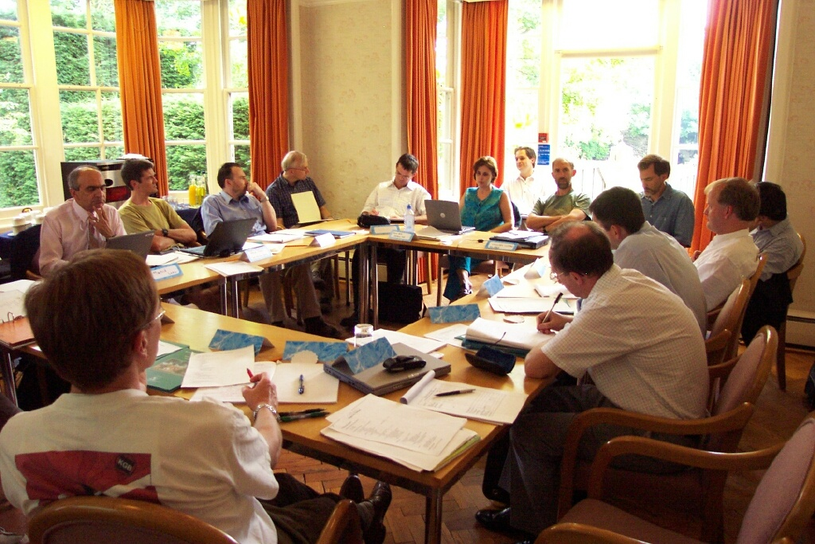
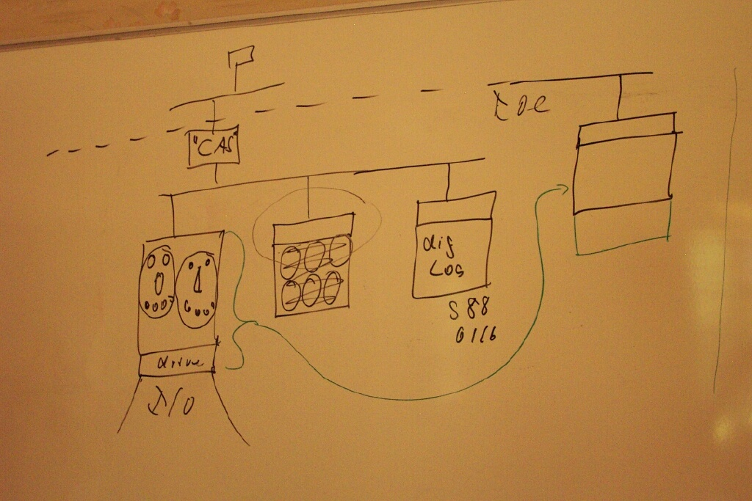
EPICS V4
In 2003 we tried to plan “EPICS2010”
Out of which came .......
EPICS V4
EPICS V4 session at this meeting
Extends capability of EPICS
Services
Data acquisition
Part of the future
Importance of V3 interoperability

Slide 22
Diamond 2013

Slide 23
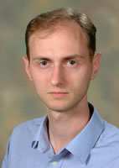
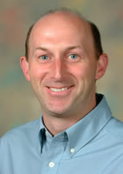
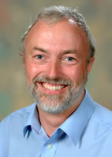
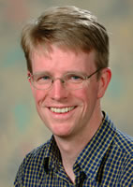
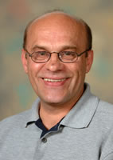
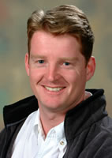
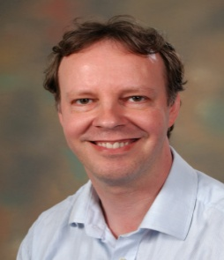
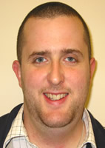
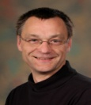
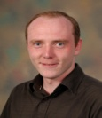
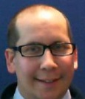
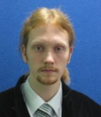
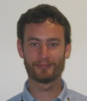
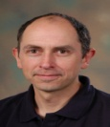
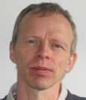
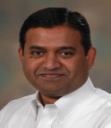
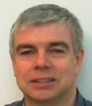
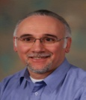
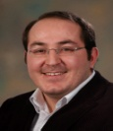
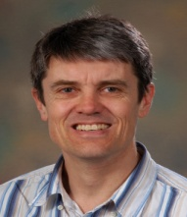
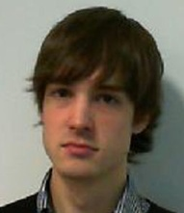
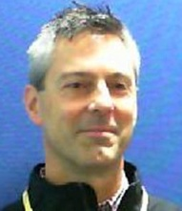
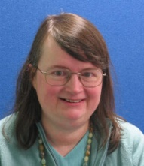
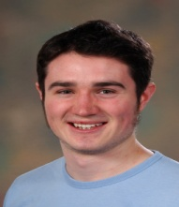
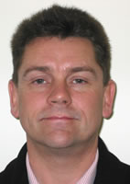
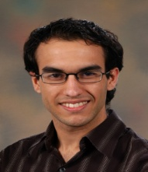
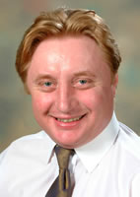
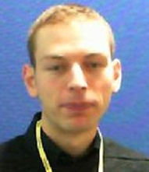
People
Work of many people
Diamond Controls Group
Industry
EPICS Collaboration

Slide 24
Thank you.
Questions?
A Decade of EPICS on Diamond
EPICS Collaboration Meeting 1st – 3rd May 2013

